Slide 1
Unit 3 - Process Deadlock

Slide 2
Introduction
System consists of resources
Resource types R₁, R₂, . . ., R_{m}
CPU cycles, memory space, I/O devices
Each resource type R_{i} has W_{i} instances.
Each process utilizes a resource as follows:
request
use
release

Slide 3
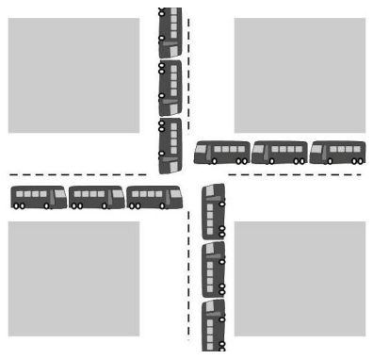
Introduction (contd.)
A process in a multiprogramming system is said to be in dead lock if it is waiting for a particular event that will never occur
Example:
All automobiles trying to cross
Traffic Completely stopped
Not possible without backing some

Slide 4
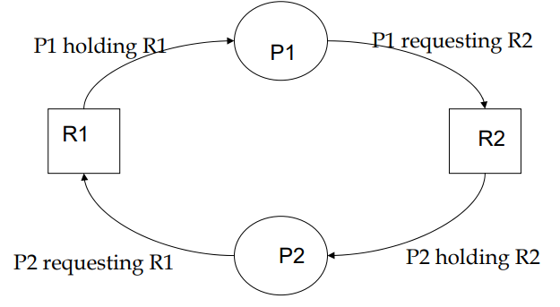
Resource Deadlock
A process request a resource before using it, and release after using it
If the resource is not available when it is requested, the requesting process is force to wait
Process P1 holds resource R1 and needs resource R2 to continue; Process P2 holds resource R2 and needs resource R1 to continue – deadlock

Slide 5
Deadlock Characterization
Deadlock can arise if four conditions hold simultaneously.
Mutual exclusion: only one process at a time can use a resource
Hold and wait: a process holding at least one resource is waiting to acquire additional resources held by other processes
No preemption: a resource can be released only voluntarily by the process holding it, after that process has completed its task
Circular wait: there exists a set {P₀, P₁, …, P_{n}} of waiting processes such that P₀ is waiting for a resource that is held by P₁, P₁ is waiting for a resource that is held by P₂, …, P_{n–1} is waiting for a resource that is held by P_{n}, and P_{n} is waiting for a resource that is held by P₀.

Slide 6
Resource-Allocation Graph
A set of vertices V and a set of edges E.
V is partitioned into two types:
P = {P₁, P₂, …, P_{n}}, the set consisting of all the processes in the system
R = {R₁, R₂, …, R_{m}}, the set consisting of all resource types in the system
request edge – directed edge P_{i} → R_{j}
assignment edge – directed edge R_{j} → P_{i}

Slide 7
Resource-Allocation Graph (Cont.)
Process
Resource Type with 4 instances
P_{i} requests instance of R_{j}
P_{i} is holding an instance of R_{j}
P_{i}
R_{j}
R_{j}
P_{i}

Slide 8
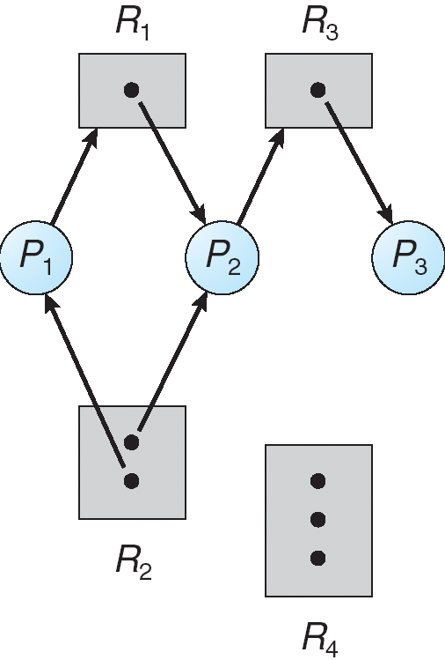
Example of a Resource Allocation Graph

Slide 9
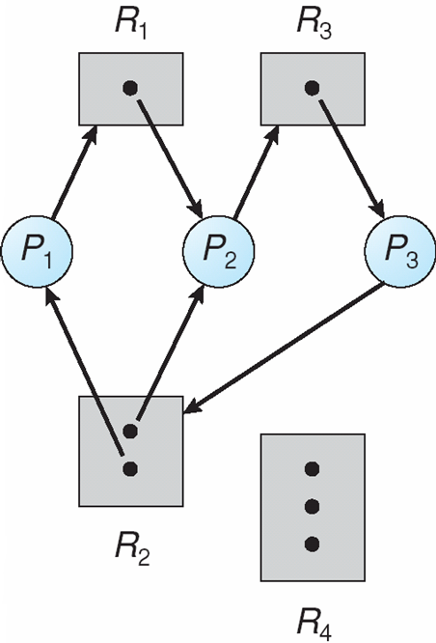
Resource Allocation Graph With A Deadlock

Slide 10
Basic Facts
If graph contains no cycles ⇒ no deadlock
If graph contains a cycle ⇒
if only one instance per resource type, then deadlock
if several instances per resource type, possibility of deadlock

Slide 11
Methods for Handling Deadlocks
Ensure that the system will never enter a deadlock state:
Deadlock prevention
Deadlock avoidance
Allow the system to enter a deadlock state and then recover
Ignore the problem and pretend that deadlocks never occur in the system; used by most operating systems, including UNIX

Slide 12
Deadlock Prevention
Mutual Exclusion – not required for sharable resources (e.g., read-only files); must hold for non-sharable resources
Hold and Wait – must guarantee that whenever a process requests a resource, it does not hold any other resources
Require process to request and be allocated all its resources before it begins execution, or allow process to request resources only when the process has none allocated to it.
Low resource utilization; starvation possible

Slide 13
Deadlock Prevention (contd.)
No Preemption –
If a process that is holding some resources requests another resource that cannot be immediately allocated to it, then all resources currently being held are released
Preempted resources are added to the list of resources for which the process is waiting
Process will be restarted only when it can regain its old resources, as well as the new ones that it is requesting
Circular Wait – impose a total ordering of all resource types, and require that each process requests resources in an increasing order of enumeration

Slide 14
Ostrich Algorithm
A strategy of ignoring problem on the basis that they may be exceedingly rare
“To stick one’s head in the sand and pretend there is no problem”
Used when it is cost-effective to allow the problem rather than its prevention

Slide 15
Deadlock Detection
The system does not attempt to prevent deadlocks from occurring
Instead, it lets them occur, tries to detect when this happens, and then takes some action to recover after the fact
Different approaches:
Deadlock Detection with One Resource of Each Type
Deadlock Detection with Multiple Resource of Each Type

Slide 16
Deadlock Detection with One Resource of Each Type
If resource graph consists one or more cycle then deadlock occurs
If no cycle then no deadlock
Here, one resource of each type exists (one scanner, one printer, etc.)
Is this System Deadlocked? If so which process are involved?
Process A holds R and wants S
Process B holds nothing but wants T
Process C holds nothing but wants S
Process D holds U and wants S and T
Process E holds T and wants V
Process F holds W and wants S
Process G holds V and wants U

Slide 17
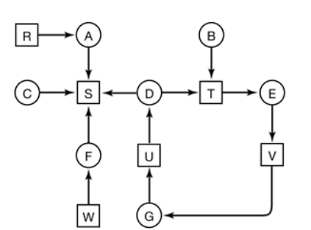
Deadlock Detection-One Resource (contd.)

Slide 18
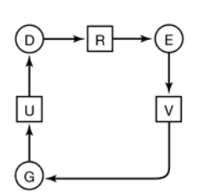
Deadlock Detection-One Resource (contd.)
After Extraction:

Slide 19
Deadlock Detection with Multiple Resources of Each Type
Multiple copies of resources available
A matrix-based algorithm in order to detect deadlock
n processes. P1 through Pn
E is the existing resource vector
A be the available resource vector
two arrays, C, the current allocation matrix, and R, the request matrix
Cij is the number of instances of resource j that are held by process i
Rij is the number of instances of resource j that Pi wants

Slide 20
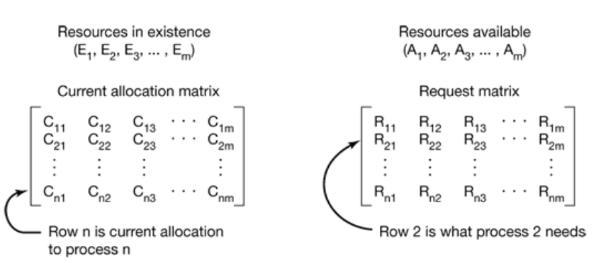
Deadlock Detection - Multiple Resources (contd.)

Slide 21
Deadlock Detection - Multiple Resources (contd.)
The deadlock detection algorithm can now be given, as follows.
Look for an unmarked process, Pi , for which the i-th row of R is less than or equal to A
If such a process is found, add the i-th row of C to A, mark the process, and go back to step 1
If no such process exists, the algorithm terminates.

Slide 22
Example
Process | Allocated | Request | Available
P0 | 0 1 0 | 0 0 0 | 0 0 0
P1 | 2 0 0 | 2 0 2 | 0 1 0
P2 | 3 0 3 | 0 0 0 | 3 1 3
P3 | 2 1 1 | 1 0 0 | 5 2 4
P4 | 0 0 2 | 0 0 2 | 5 2 6 7 2 6
A | B | C
7 | 2 | 6
Work = available

Slide 23
Recovery from Deadlock
Recovery through Preemption
Temporarily take a resource away from its current owner and give it to another process
Recovery through Rollback
When a deadlock is detected, it is easy to see which resources are needed.
To do the recovery, a process that owns a needed resource is rolled back to a point in time before it acquired some other resource by starting one of its earlier checkpoints.
Recovery through Killing Processes
Kill one or more processes

Slide 24
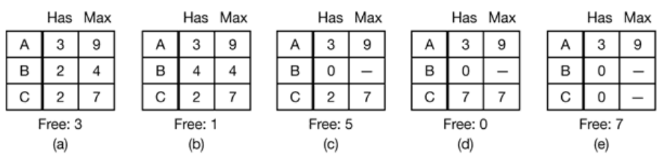
Deadlock Avoidance - Safe and Unsafe State
A state is said to be safe if it is not deadlocked and there is a some scheduling order in which every process can run to completion
In a safe state, system can guarantee that all processes will finish – no deadlock occur
For an unsafe state, no such guarantee can be given – deadlock may occur.

Slide 25
Banker’s Algorithm
This approach to the deadlock problem anticipates a deadlock before it actually occurs
This approach employs an algorithm to access the possibility that deadlock could occur and act accordingly
It is named as Banker’s algorithm because the process is analogous to that used by a banker in deciding if a loan can be safely made a not

Slide 26
Banker’s Algorithm (contd.)
The following are the features that are to be considered for avoidance of the deadlock s per the Banker’s Algorithms
Each process declares maximum number of resources of each type that it may need
Keep the system in a safe state in which we can allocate resources to each process in some order and avoid deadlock
Check for the safe state by finding a safe sequence: where resources that Pi needs can be satisfied by available resources plus resources held by Pj where j < I
Resource allocation graph algorithm uses claim edges to check for a safe state

Slide 27
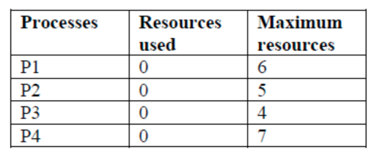
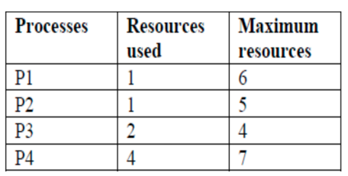
Banker’s Algorithm (contd.) For Single Resource
Consider an analogy in which 4 processes (P1, P2, P3 and P4) can be compared with the customers in a bank, resources such as printers etc. as cash available in the bank and the Operating system as the Banker

Slide 28
Banker’s Algorithm (contd.) For Multiple Resource
Process | Allocated | Request | Available
P0 | 0 1 0 | 0 0 0 | 0 0 0
P1 | 2 0 0 | 2 0 2 | 0 1 0
P2 | 3 0 3 | 0 0 0 | 3 1 3
P3 | 2 1 1 | 1 0 0 | 5 2 4
P4 | 0 0 2 | 0 0 2 | 5 2 6 7 2 6
A | B | C
7 | 2 | 6
Work = available

